Slide 1
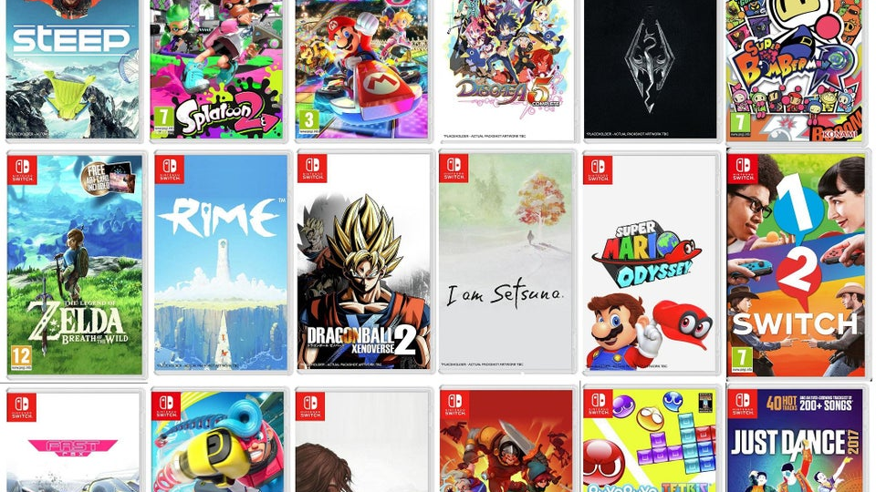
Nintendo Switch game Analysis
By Xiaogang Zhu

Slide 2
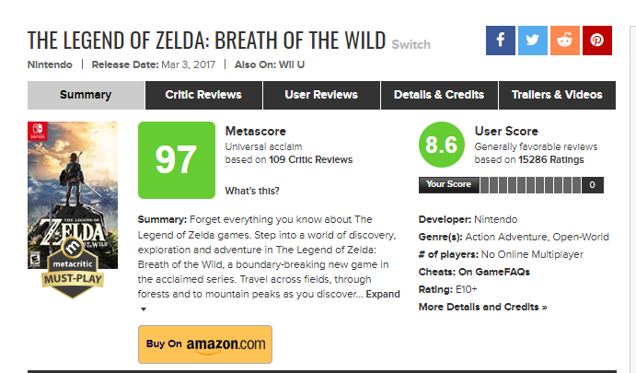
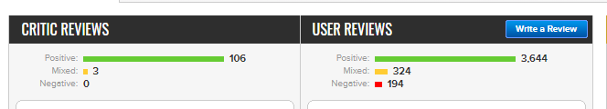
Data
4150 Observations,16 Variables after cleaning the data set

Slide 3

Questions to ask
Popularity
Which kind of game is popular?
Which developer's game is the most popular?
Success
Which game is the most successful?
Which developer’s game is the most successful?
Online Service
How to make more people pay for the online service?
Different Platform makes a difference?
How is the games that transferred from other platform perform?

Slide 4

Popularity
What makes a game popular?
Games that have more ratings
Games that have more reviews
Measure Variables:
Rating count
Total reviews count
The Legend of Zelda: Breath of the Wild
Rating count:15248
Total reviews count: 5401

Slide 5
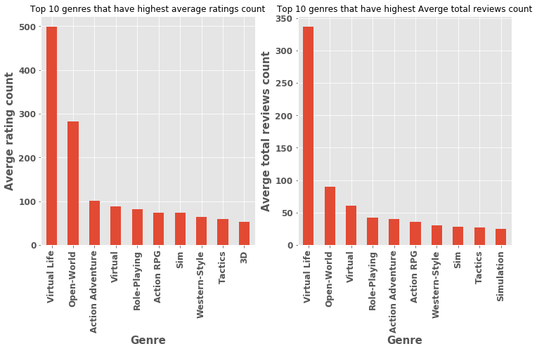
Which kind of game is popular?

Slide 6
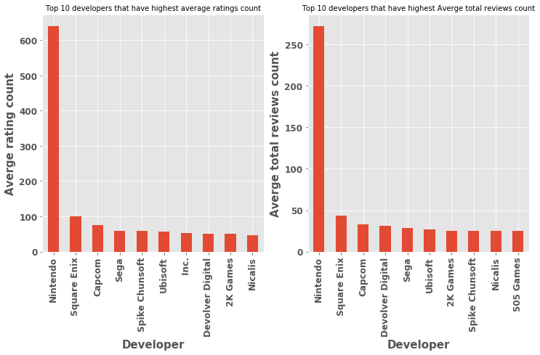
Which developer's game is the most popular?

Slide 7

Success
Which game is the most successful?
What makes a game success?
Games that have high scores in both meta score and user score
Measure Variables:
Average of meta score and user score
Super Mario Odyssey
Average score:93

Slide 8
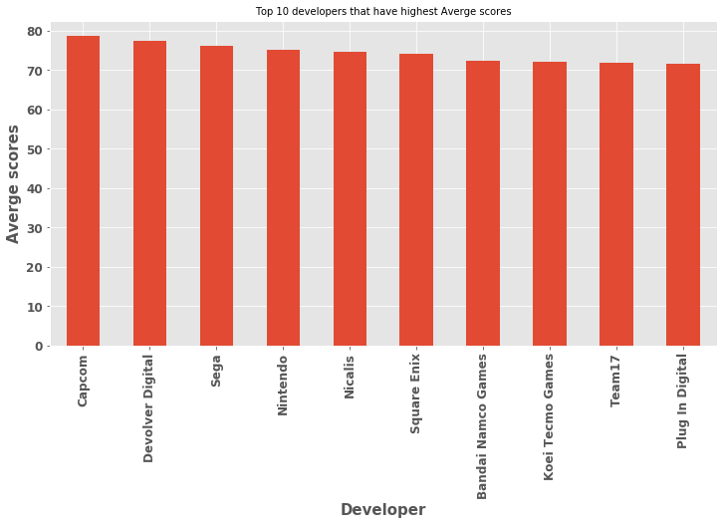
Which developer’s game is the most successful?

Slide 9
Online service
Only 18% (750 out of 4150) games can be played online.
online group vs not online group
Compare two groups’ popularity and success

Slide 10
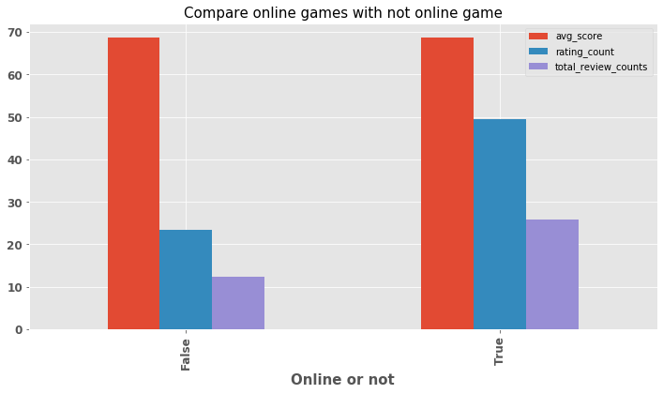
Result

Slide 11
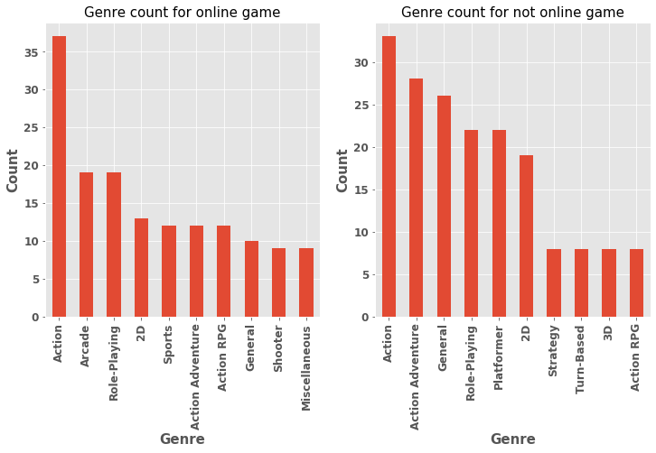
How to make more people pay for the online service?
Top 100 high rating count games from each group
Top 10 games genre in each group
Make more games which can take advantage of online service.

Slide 12
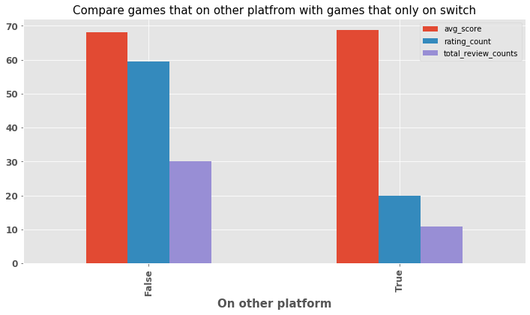
Different Platform makes a difference?
How is the games that transferred from other platform perform?

Slide 13
Conclusion
The most popular game genre : Virtual Life, Open-World
Developer that makes the most popular games: Nintendo. However, their games is not considered the most successful. It will be very useful to look at Nintendo games strategy.
Nintendo should make more games which can take advantage of online service such as arcade, shooter games to make more people pay for the online service.
Games that are transferred from other platform perform bad than games that are only on switch.

Slide 14
Future work
If we are given the selling data, can we predict game selling based on their popularity or success?
Some games have high user and meta score may because of insufficient rating and reviews, how can we overcome this issue?
Look at one specific big brand like Nintendo and try to figure out what’s their strategy which might be very useful for other developers.
What is the distribution of the release date? Does it have a relationship with games' popularity or success?
For some specific games, is there any difference between their critic reviews and user reviews?
Scrape all user review and critic review and do sentiment analysis to see how people actually think of a specific game.

